Slide 1

Youth Basketball Coaches Training
City of Coconut Creek

Slide 2

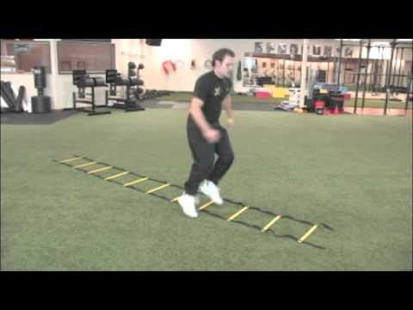
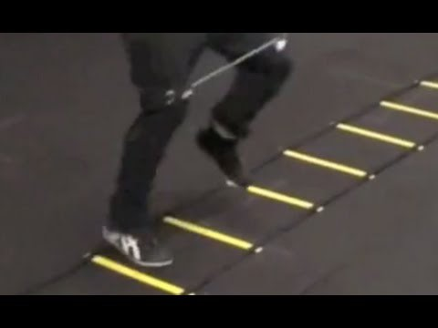
Warm-Up
Dynamic Stretching
Skip, High Knees, Butt Kicks, Lunges, Frankenstein's, Karaoke, Shuffles, 2 Sprints
Agility Ladder

Slide 3
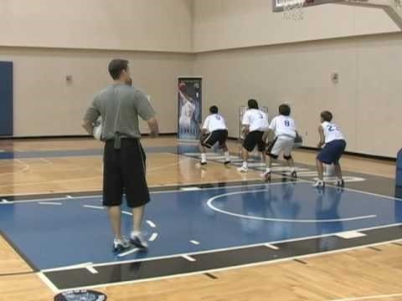
Dribbling
Stationary Dribble Drill
Teach proper form (Line up players, eyes up, stand sideways, opposite hand out for defense)
Dribble in motion – Left hand, right hand
Cone Stacking
https://www.youtube.com/watch?v=H3ZBGium6Ao
Red Light, Green Light
(Red Light - Jump Stop, Green Light - Dribble)
Lateral Dribbling Drill
Select an offensive and defensive player
On the whistle, the offensive player dribbles to the Right (Ball in Right hand) while the defensive player slides their feet
On the next whistle, the offensive player uses a cross over and dribbles to the left (Ball in left hand) while the defensive player slides their feet

Slide 4
Dribbling
Forward and Backwards Drill
https://www.youtube.com/watch?v=iJUm0ul4taE
Cones
Start by having players do one dribble before the crossover and then add two dribbles
Line up two sets of cones and add a right or left handed layup to finish the drill or jump shot (Coach can play defense on the shot to get practice shooting over defenders)
https://www.youtube.com/watch?v=1Sp_dQorGvA

Slide 5
Passing
Pass & Flow Drill
https://www.youtube.com/watch?v=UxN-i7WnOGs
Shovel Pass Drill
https://www.youtube.com/watch?v=Lr0zBmUQDyk&list=PLmPIogZWH3R6gI4Hru6TKxf0XTz4UMN39&index=24
Partner Running Pass Drill
Can also do this drill shuffling feet (go to half court and back, bounce pass on the way down and chest pass on the way back
https://www.youtube.com/watch?v=scQxZL2KYrA&index=31&list=PLmPIogZWH3R6gI4Hru6TKxf0XTz4UMN39
3 Man Weave Drill
https://www.youtube.com/watch?v=qe-QLhE1hgw

Slide 6
Shooting
Fundamentals of Shooting
https://www.youtube.com/watch?v=t7ciq_x4138
Form Shooting
Have player shoot against a wall before using the basket
Begin using one hand and start 2 feet away from the basket
Player can be in front or on left or right side of hoop
3 players at each basket, have players shoot one at a time with one hand
Position one player on left side of hoop, right side of hoop and in front of hoop
Once this is covered, add other hand (this hand is used as a guide)

Slide 7
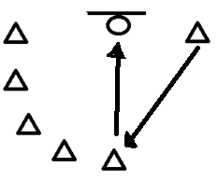
Shooting
Shooting on the pass
Have all players get into a line behind left cone but have one player start at the right cone
On the whistle, the player at the right cone will run around the cones
The player at the left cone will pass the ball and the player shoot a jump shot
After a few times through add defense
The passing player will tell the offensive player to go and pass the ball. On the whistle, the passing player will defend the shot

Slide 8
Defense & Rebounding
Side/Lateral Drill
https://www.youtube.com/watch?v=j7JUvMrXLRk
Box out Drill
https://www.youtube.com/watch?v=bhTAm_1UflA
Toss & Rebound Drill
Once players understand the correct box out position, have players box out the next player in line
https://www.youtube.com/watch?v=rjAT8hKlSuw
Man to Man Defense
https://www.youtube.com/watch?v=iuqBDuSSXik

Slide 9
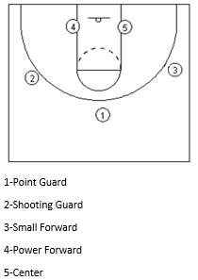
Positions
Place players in their suggested position. Point guard will start
with the ball (1).
On the whistle, the point guard will swing the ball to the right or left
(2 or 3). This will happen on every whistle until the coach yells “down low”.
When the coach yells “down low” the ball is passed down low.
When the coach yells “shot” the player takes a shot.
If players 1, 2, or 3 have the ball and the coach
yells “dribble” the player with the ball will dribble in and shoot.
Once the ball is shot, all players will go in for the rebound.
Once players understand positions, add a defense
and let players do drill on their own with a 4 pass rule
before a shot.

Slide 10
Offense
Fake Pass & Drive Drill
https://www.youtube.com/watch?v=lwIiXSVdj14
V-Cut Layup Drill
https://www.youtube.com/watch?v=QSzapEqhOaE
Give & Go Drill
https://www.youtube.com/watch?v=wH79CAnB9Vw
Backdoor Pass Layup Drill
https://www.youtube.com/watch?v=l0LQMgMqFUE
Drop step Layup Drill
https://www.youtube.com/watch?v=4tdZeJcyXf0
Fast Break Drill
https://www.youtube.com/watch?v=dM83SbRgFQk
Pick & Roll
https://www.youtube.com/watch?v=ffjo8ReDzhA
3 Dribble One on One Drill
Line players up at free throw line and force players to drive to the basket
(Only allow players to take 3 dribbles)

Slide 11
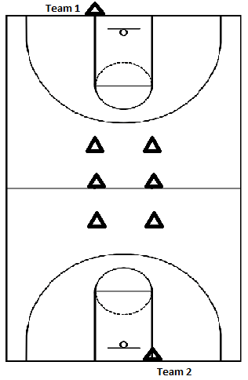
Games
Relay
Dribble length of court through the cones,
score right handed lay up/rebound (3 Attempts),
dribble back through the middle of the cones,
and bounce pass to teammate
Knockout
Scrimmage

