Slide 1
CincyCentral Referee Training
March 7, 2015
Evendale Recreation Center

Slide 2
CincyCentral Referee Training
Referee Test Review
Question and Answers

Slide 3
CincyCentral Referee Training
March 7, 2015
Evendale Recreation Center

Slide 4
Points of Emphasis for Referees
The following slides address some points of emphasis for both new and returning CincyCentral SAY Referees.
These items are the result of observations and feedback from referees/coaches/parents at all levels of SAY Soccer.

Slide 5
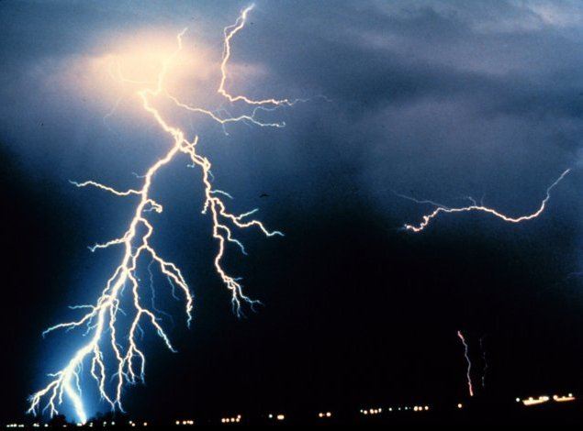
SAY Soccer Lightning Policy
If either of the two things below happens, the referee should immediately suspend the game.
If thunder is heard
If lightning is seen

Slide 6
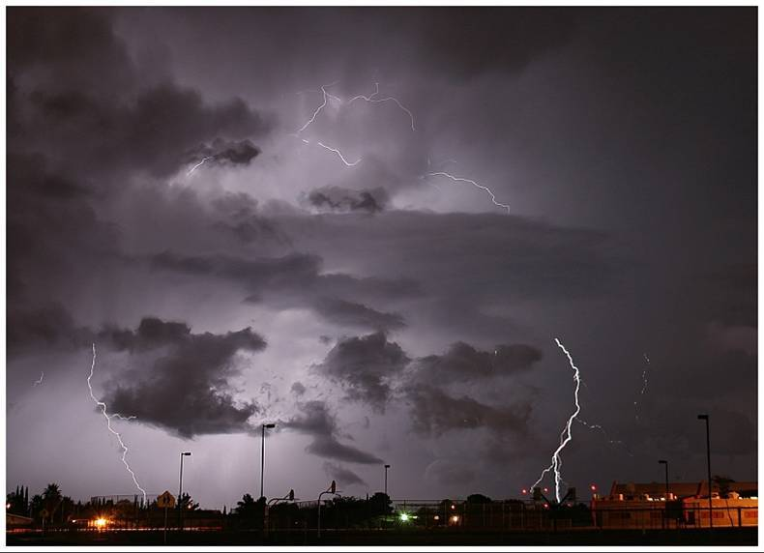
SAY Soccer Lightning Policy
Whatever Occurs FIRST:
If you see lightning of any sort
Stop the game immediately
If you hear thunder, even in the distance
Stop the game immediately
DO NOT WAIT to see or hear a second signal to confirm.
Lightning Detectors
Lightning Detectors

Slide 7
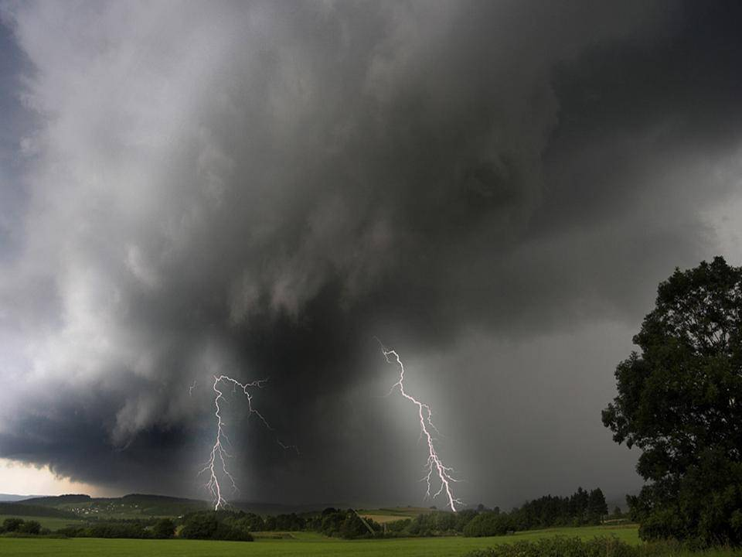
WHAT TO DO ??
SAY Soccer Lightning Policy
No one should retake the field for a minimum of 30 minutes after the last lightning is seen or thunder is heard.
The 30 minutes is restarted every time lightning is seen or thunder is heard !!

Slide 8
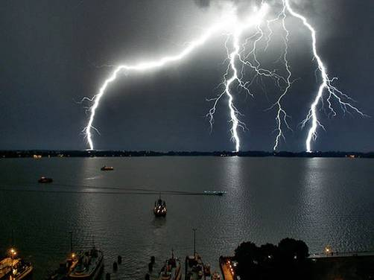
REMEMBER !!
DO NOT WAIT!!
STOP IMMEDIATELY!!
NO game is that important !!

Slide 9


Slide 10

Goalkeeper Possession
Law XII, Notes 1 states the following:
  “Possession” by the goalkeeper is having control, even if only with one hand.
PLEASE use this definition when asked by a coach/player/parent as to what Goalkeeper possession means/entails.
ONE FINGER does NOT equal ONE HAND!

Slide 11
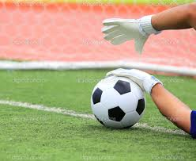

Slide 12
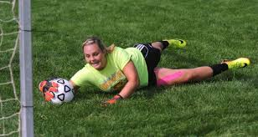
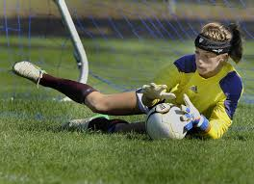

Slide 13
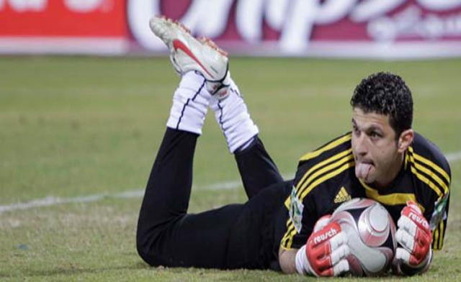

Slide 14
Goalkeeper Possession
Goalkeepers ARE ALLOWED to be the first to handle the ball after releasing it into play (i.e. punting/throwing/dropping the ball) at the Passers (U8) and Wings (U10) levels.
Goalkeepers ARE NOT ALLOWED to be the first to handle the ball after releasing it into play (i.e. punting/throwing/dropping the ball) at the the Strikers (U12) level and UP.

Slide 15
Passing Back to the Goalkeeper
Goalkeepers ARE ALLOWED to handle the ball if kicked to them by a teammate at the Passers (U8) and the Wings (U10) levels.
Goalkeepers ARE NOT ALLOWED to handle the ball if kicked to them by a teammate at the Strikers (U12) level and UP.

Slide 16
Age & Skill Appropriate Fouls
The younger age groups (Passers and Wings) are seeing the most inconsistencies when it comes to fouls called by referees.
REMEMBER: Call the game for the ages/skills of the players involved. DO NOT call the game the way YOU would PLAY the game!!
Especially at the younger levels … if it is a FOUL – BLOW THE WHISTLE AND CALL IT!

Slide 17
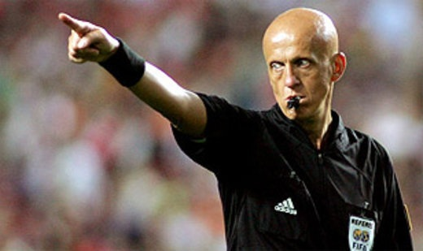

Slide 18
Game Cards and Reporting
Referees are REQUIRED to have the coaches sign the official game card after each match.
  It is the responsibility of BOTH referees assigned to the match to make sure the card is signed.
  If a coach refuses to sign, you MUST note the reason on the card and make sure your Assignor is aware of the problem.
  If you forget – report the problem to your Assignor immediately.

Slide 19
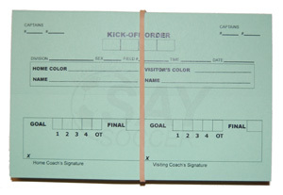
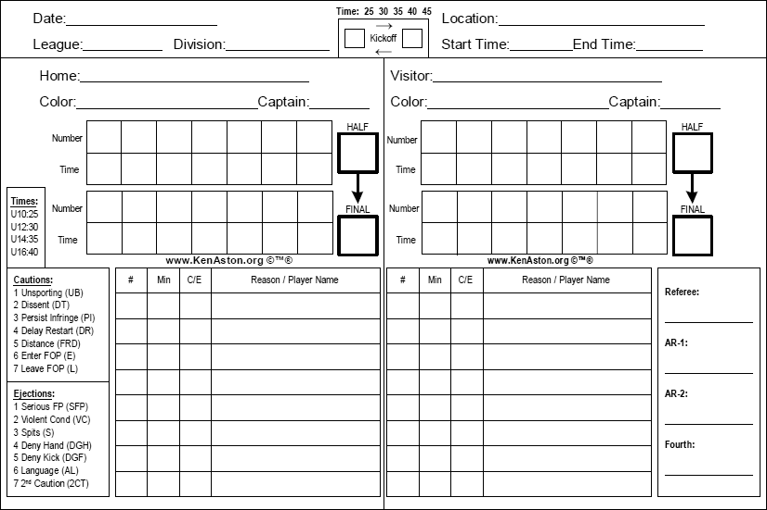

Slide 20
Game Cards and Reporting
Why is getting a game card signed so important?
  Law V describes the role of the Referee in a match, one of which is to keep the official score.
  The game card is the official record of the match. If there are any discrepancies/disputes regarding the final score of the match, the card is the first reference point.
  Signature on the card = official agreement that the final score/outcome is correct.

Slide 21
Game Cards and Reporting
Why is getting a game card signed so important? (continued …)
  If the card is not signed, the game may be replayed if the dispute cannot be resolved.
  If a player or coach was cautioned or sent-off, the card (and subsequent report) will be the official reference point for any additional discipline.

Slide 22
Game Cards and Reporting
I got to the field and I don’t have a card. Now what do I do?
  If you don’t have an official game card … don’t panic.
    Ask your partner if they have one.
    IF neither of you have a card, see if someone on a neighboring field has one.
    IF you can’t get an official one … an index card or piece of paper will work. Make sure you get it SIGNED after the game – the coaches and ref signatures MAKE it official.

Slide 23
Game Cards and Reporting
What is a Game Report?
  A game report is filed when an incident needs to be reported to the Area/District for additional action.
  Examples:
    Red Card for player/coach/spectator
    Serious injury
    Game was suspended/terminated due to weather, irresponsible behavior, etc.

Slide 24
Game Cards and Reporting
Where do I find one?
  CincyCentral is working on an official game report for red card and major incidents.
  Ask your local Assignor how they would like you to handle game reports.
    Most assignors will be OK with an e-mail from you regarding the situation.
    Make sure to include the Who, What, Where, When, and How of what happened.
    If language is involved … we need to know what was said EXACTLY (don’t pull punches or edit inappropriate words!)

Slide 25


Slide 26
Is the Field you’re using SAFE?
Part of the duties of a referee is to inspect and ensure the field is safe to be used.
Law I, Note 9: If the referee determines the field is unsafe for play, the game will be abandoned.
Law V, Section 4, D, 1: A referee may refuse to start a game, or may stop it once play has started, if in the referee’s judgment, the condition of the field is such to endanger the players.

Slide 27
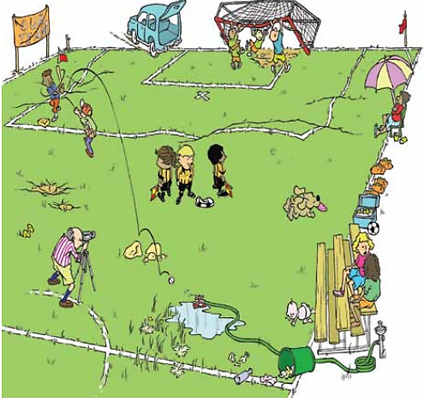

Slide 28
Is the Field you’re using SAFE?
What to look for:
  Goal anchoring/safety
  Goal net tie downs
  Sticks/large stones/broken glass/general debris on field
  Holes/divots
  Puddles/standing water on field (especially goal mouths)
  Light/Visibility

Slide 29
Is the Field you’re using SAFE?
Goals
Goals are heavy, metal/wood structures that an easily seriously injure or cause the death of a person if it falls on them.
The United States Consumer Product Safety Commission (CPSC) has found that since 1979 at least 36 deaths are directly the result of a soccer goal falling over onto a person (usually a player). That translates to one fatality a year.

Slide 30
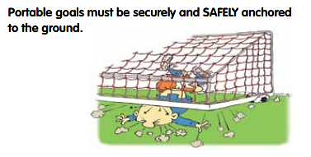

Slide 31
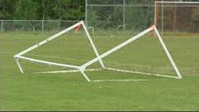

Slide 32
Is the Field you’re using SAFE?
Goals
How to check a goal?
  Goal anchors should be visible on the sides/rear of the goal frame. If you don’t see them, there may be a problem.
  Sandbag weights are excellent ways to anchor a goal – there should be at least one on each side and one on the rear (two preferable).
  If you’re not sure … grab one of the posts and give it a light pull. If you see the back/sides of the net lift off the ground – YOU HAVE A PROBLEM!!!!

Slide 33
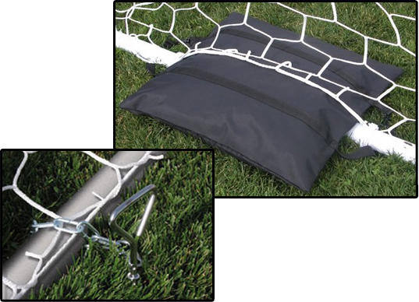

Slide 34
Is the Field you’re using SAFE?
Goals
If the goal is not anchored …
If the goal is not weighted correctly to the ground …
If you feel the goals are not safe in any way …
IF IT CAN’T BE FIXED – DO NOT PLAY!!!!

Slide 35
Is the Field you’re using SAFE?
Goal Netting/Netting Tie-Downs
While you’re checking the goals … check the nets too.
Note any holes in the netting, especially near the posts/crossbar.
If you can re-anchor the netting to the post, do so.
  Normally there are hooks on the backsides of the crossbar/posts to secure the nets to the frame.

Slide 36
Is the Field you’re using SAFE?
Goal Netting/Netting Tie-Downs
If there’s no hooks/tie downs, sometimes other items are used.
  If there’s tape securing the nets to the frame, make sure there’s nothing sticking out into the goal that may injure a player.
  If there are zip-ties or other plastic items – make sure there are no tabs or long strands of plastic sticking out into the goal area. That can poke out/scratch an eye! Trim off items until you feel it’s safe!!

Slide 37
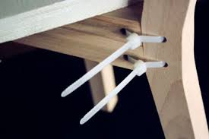

Slide 38
Is the Field you’re using SAFE?
Sticks/Large Stones/Broken Glass/General Debris
Do a “field walk” before each game (regardless of if there was a game before you got there)
Look for large sticks, large stones, broken glass, etc.
Remove what you can – get help for what you can’t (i.e. sharp glass, etc.)
If it can’t be removed: DON’T PLAY!!!

Slide 39
Is the Field you’re using SAFE?
Holes/Divots
On your “field walk” look for any holes/divots that might cause injury to players.
If there is something that needs to be fixed, see if that can be done prior to the game.
If it can’t be fixed and is NOT overly dangerous; warn both teams of what it is and where it is.
If it can’t be fixed and IS DANGEROUS: DON’T PLAY!!!

Slide 40
Is the Field you’re using SAFE?
Puddles/Standing Water
In wet/heavy rain conditions, check the field for large areas of standing water/large puddles.
Pay special attention to the goal areas/goal mouths.
Ask yourself: Can the players play safely IN or AROUND the puddles/areas of water.
If the above answer is NO … DON’T PLAY!!!

Slide 41
Is the Field you’re using SAFE?
Light/Visibility
Having enough light to see can be a concern, especially during weeknight games and in the Fall.
Pay attention to the players, especially the goalkeepers.
Don’t be afraid to ask players/GK’s if they can see enough to play.
If the above answer is NO … DON’T PLAY!!!

Slide 42
Is the Field you’re using SAFE?
Bottom Line:
Law I and Law V give the REFEREE the duty of making sure the field is safe.
While you can consult and partner with coaches … YOU are the one who makes the final decision on field conditions.
Ask yourself: Can the players play SAFELY given current field conditions?
If the above answer is NO … DON’T PLAY!!!

Slide 43


Slide 44
SAY GUIDELINES FOR REFEREE UNIFORMS
Basic Uniform:
Shoes: Predominantly Black
Socks: Knee Length with three white stripes or all black.
Shorts/Pants: Solid Black or any shorts/pants supplied by the local SAY Area/District.

Slide 45
SAY GUIDELINES FOR REFEREE UNIFORMS
Basic Uniform:
Shirt/Jersey:
  Any Referee Shirt approved by the Local SAY Area/District
  Any Referee Shirt approved and worn by USSF, High School, or Collegiate Officials
  The shirts/jerseys of all officials in a game shall be of matching color.

Slide 46
SAY GUIDELINES FOR REFEREE UNIFORMS
Referee Badge:
Any designated SAY Referee Badge earned by the official.
Any designated SAY Area/District Referee badge provided to the official.
No Referee badge need be worn.
  Referees SHOULD NOT wear USSF or NFHS badge during a SAY match.

Slide 47
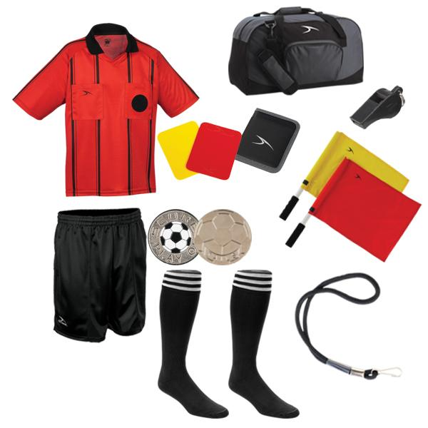

Slide 48
SAY GUIDELINES FOR REFEREE UNIFORMS
Other Items:
Hat/Visor with a bill is OK
  Solid Black is preferred.
  NO LOGOS unless it’s a SAY Soccer Logo
  Black skullcap is OK in cold weather
Eyeglasses
  Sunglasses ????
Wristwatch
Wedding Ring

Slide 49
SAY GUIDELINES FOR REFEREE UNIFORMS
Unacceptable Items:
Sunglasses????
Visible jewelry other than wedding ring
Ankle Socks
BOTTOM LINE: If a player can’t wear it, neither should YOU!

Slide 50
Field and Sideline Etiquette
Cell Phones/Smartphones
NEVER NEVER NEVER on the field of play!!
NEVER Used as a substitute for a watch/stopwatch/other timing device
BE CAREFUL using them on the sidelines … keep it short on an AS-NEEDED basis.
CAN be used for referencing the Laws of the Game and other referee-related items.

Slide 51
Field and Sideline Etiquette
Rain/Foul Weather Gear:
Umbrellas are NOT allowed to be used DURING a game. If it’s going to rain … bring rain gear or a poncho!!
Make sure you have a plastic trash bag to put your gear in if it rains!
Hats should be soccer appropriate for cold weather – if you’re not sure on wearing it, DON’T!

Slide 52


